Slide 1

St . Andrew Institute of Technology and Management ,Gurgaon-Delhi(NCR)
WELCOME

Slide 2
INTRODUCTION
NAME :-SAURAV BHARTI
DEPARTMENT :- B.TECH(C.S.T)/1st Year/sem
ROLL NO :-226024
SUBJECT :-WEB DEVELOPMENT submitted to… GRAVIT SHARMA

Slide 3

Shopping
Arena

Slide 4
OBJECTIVES
To provide a online shopping platform to the consumer’s . where the consumer gets a variety off options to buy.
To provide a list off products with a single click.
To provide a new and a unique shopping experience .
To provide a time efficient process of shopping.

Slide 5
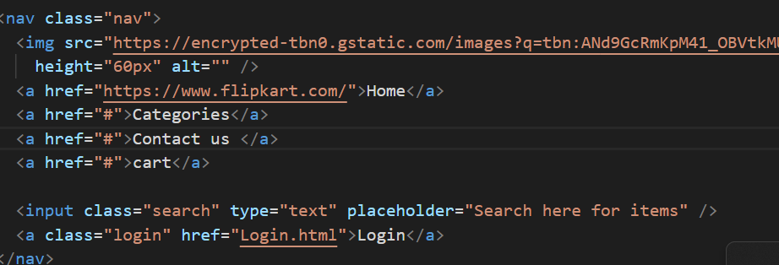
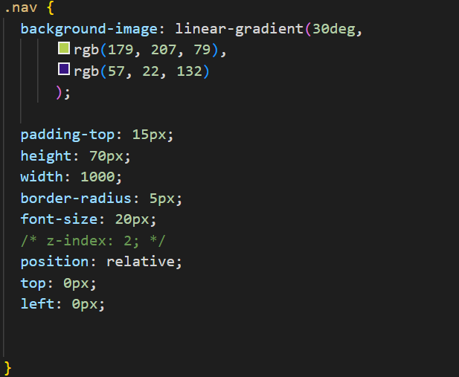
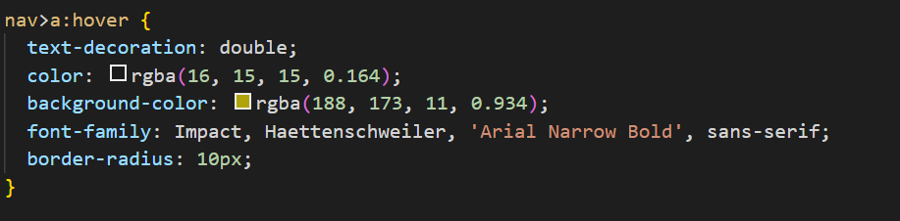
Navigation bar

Slide 6
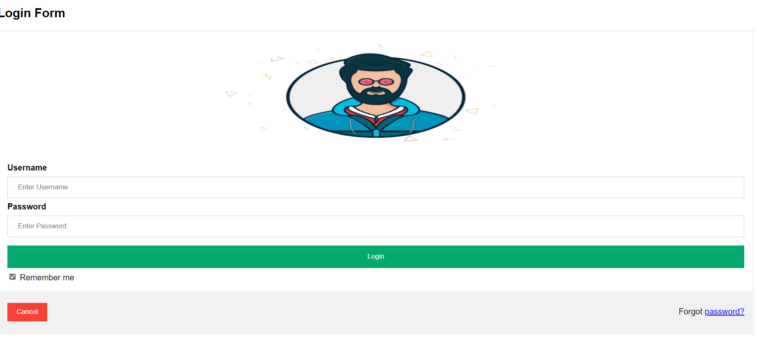
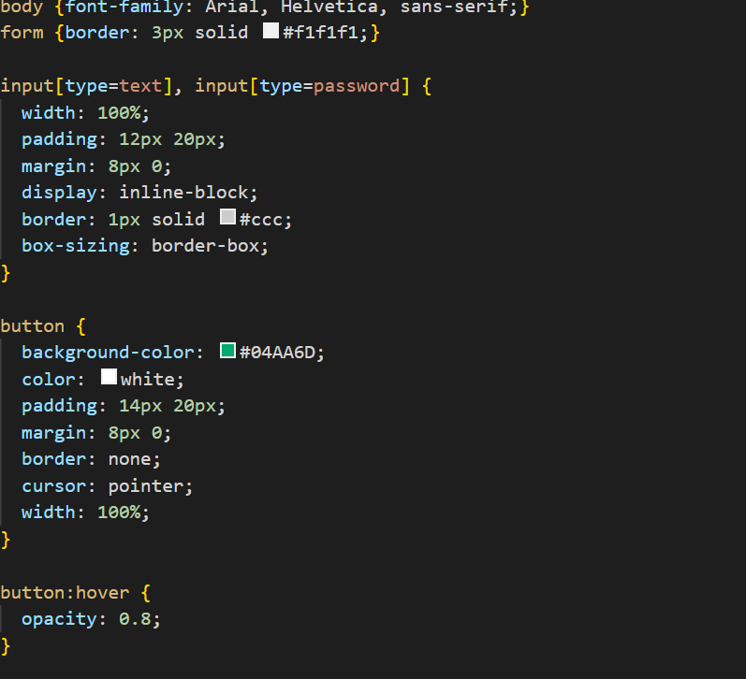
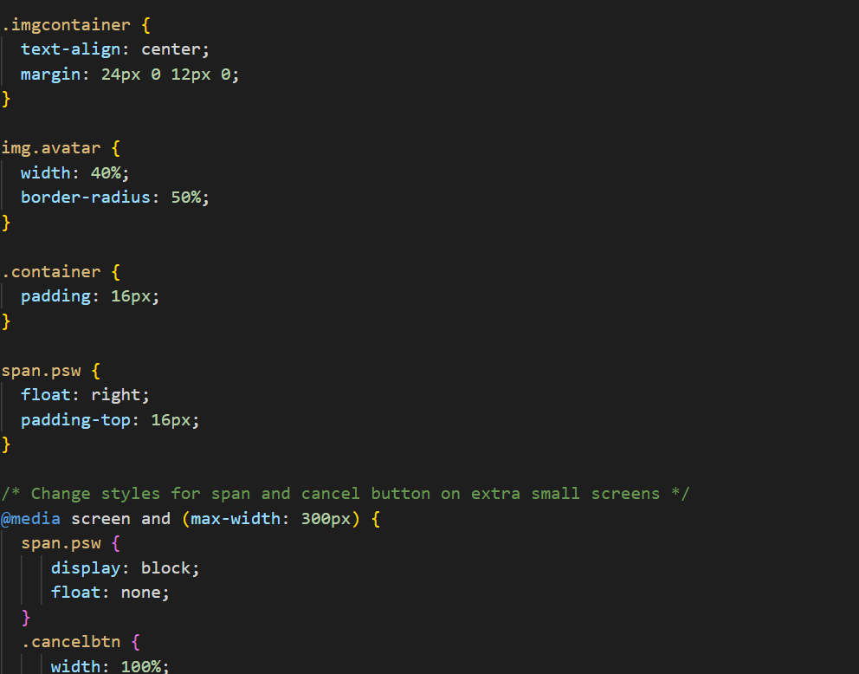
Login page

Slide 7
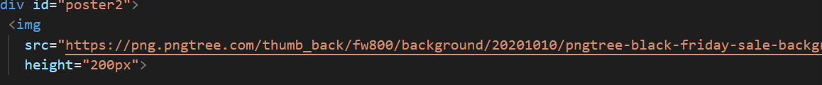
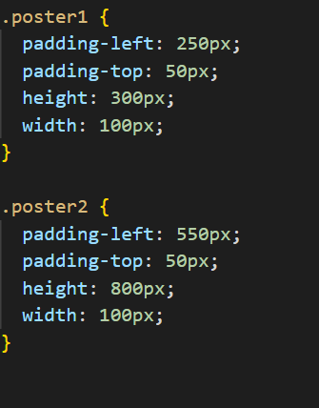

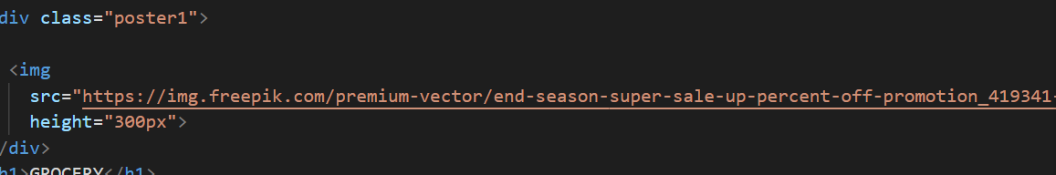
POSTER

Slide 8
.
THANK YOU

